Slide 1
Quantum Information
An Introduction

Slide 2

Introduction to Quantum Computing
A quantum computer can be understood as a physical implementation of n qubits (or other basic quantum systems), with a precise control over the evolution of the state.
Qubits are the fundamental representation of data in a discrete quantum computer.

Slide 3

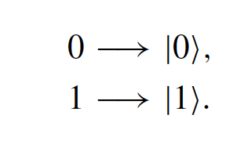
Whats a Qubit?
A qubit is realized as a quantum mechanical two-level system and as such can be measured in two states, called the basis states.
Qubits are traditionally denoted by the Dirac vectors:

Slide 4


Qubits in Dirac Notation
The Dirac vectors that represent qubits form an orthogonal basis of a 2D Hilbert space, which is called the computational basis.
As a consequence of the superposition principle of quantum mechanics the most general form of a qubit is:

Slide 5

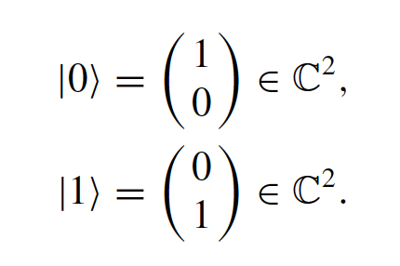

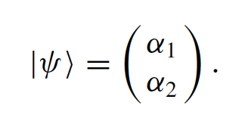
Qubits in Vector Notation
Dirac vectors has a vector representation. In vector notation, a general qubit is expressed as:

Slide 6

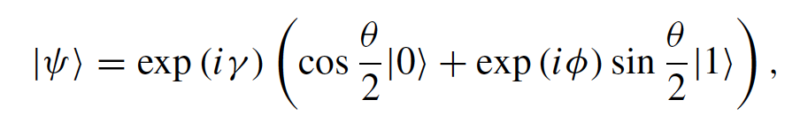

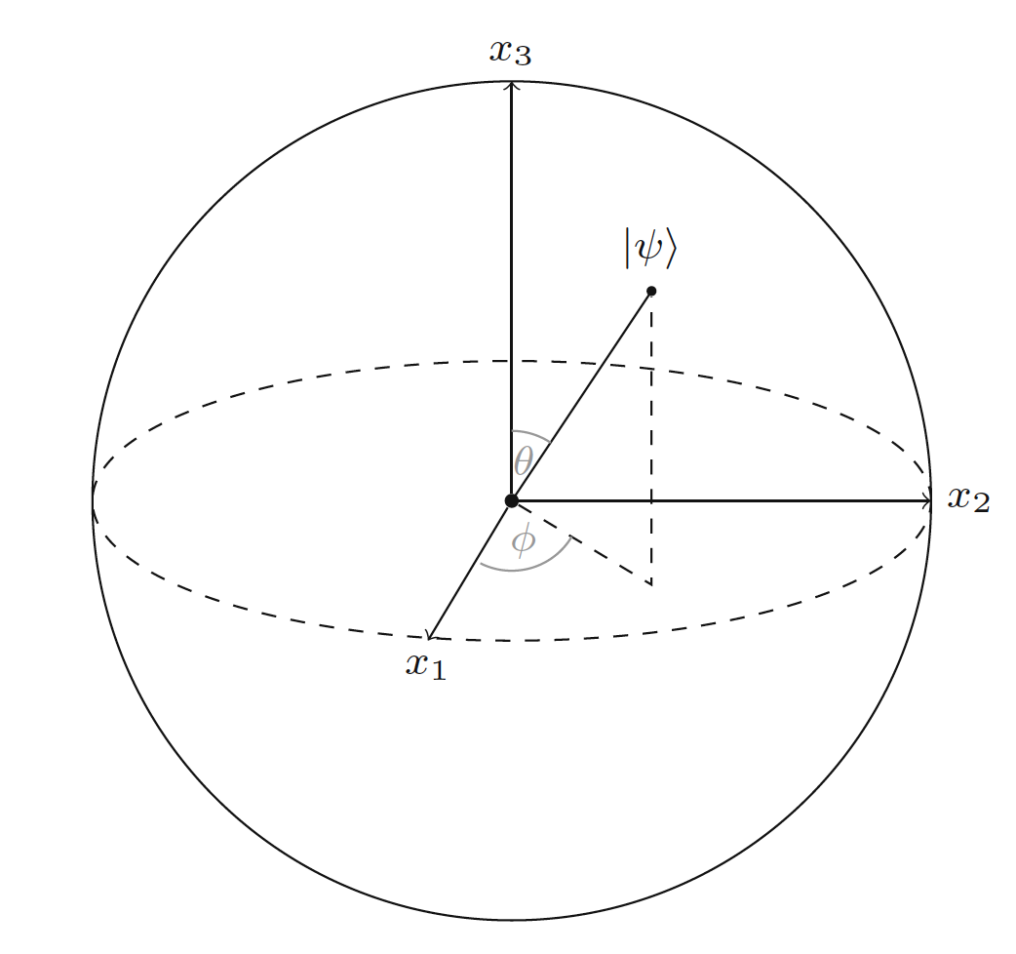
Graphical Representation of a Qubit
The third way a qubit can be represented is by use of a sphere graph, known as the Bloch sphere. The cubit can be graphed by use of the following equation:

Slide 7

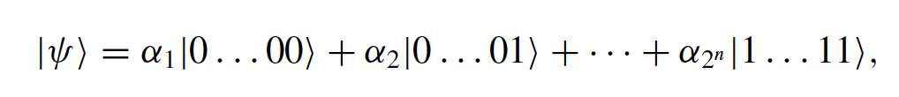

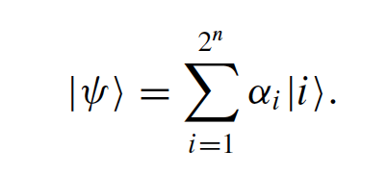
Multiple Qubit States
When multiple cubits are entangled, their collective state is no longer separable and the computation basis is read as:

Slide 8

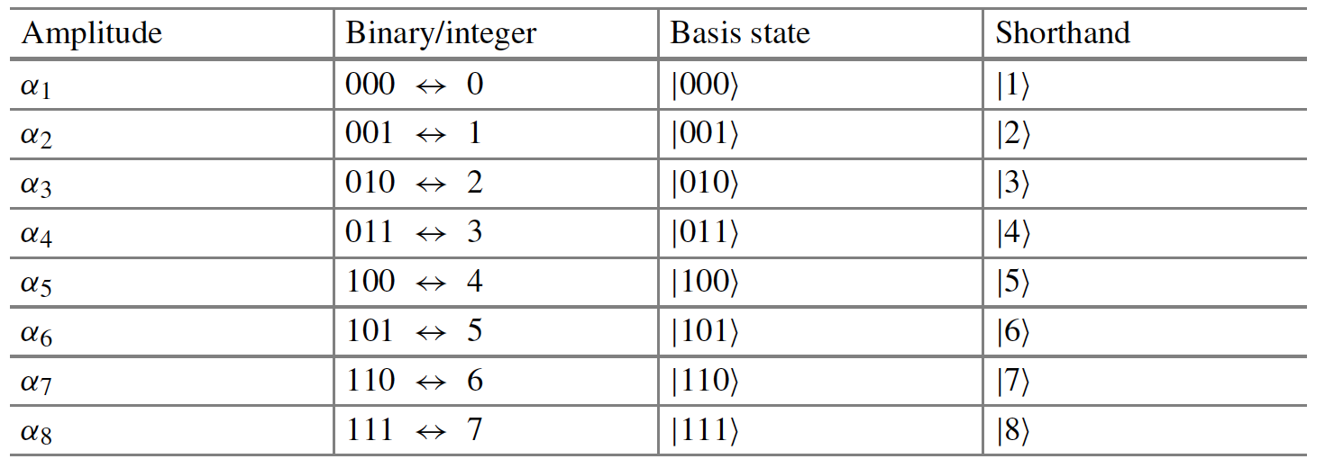
Quick Short Hand Trick

Slide 9
Quantum Gates
Two basic operations on quantum states:
Quantum logic gates
Computational basis measurements

Slide 10

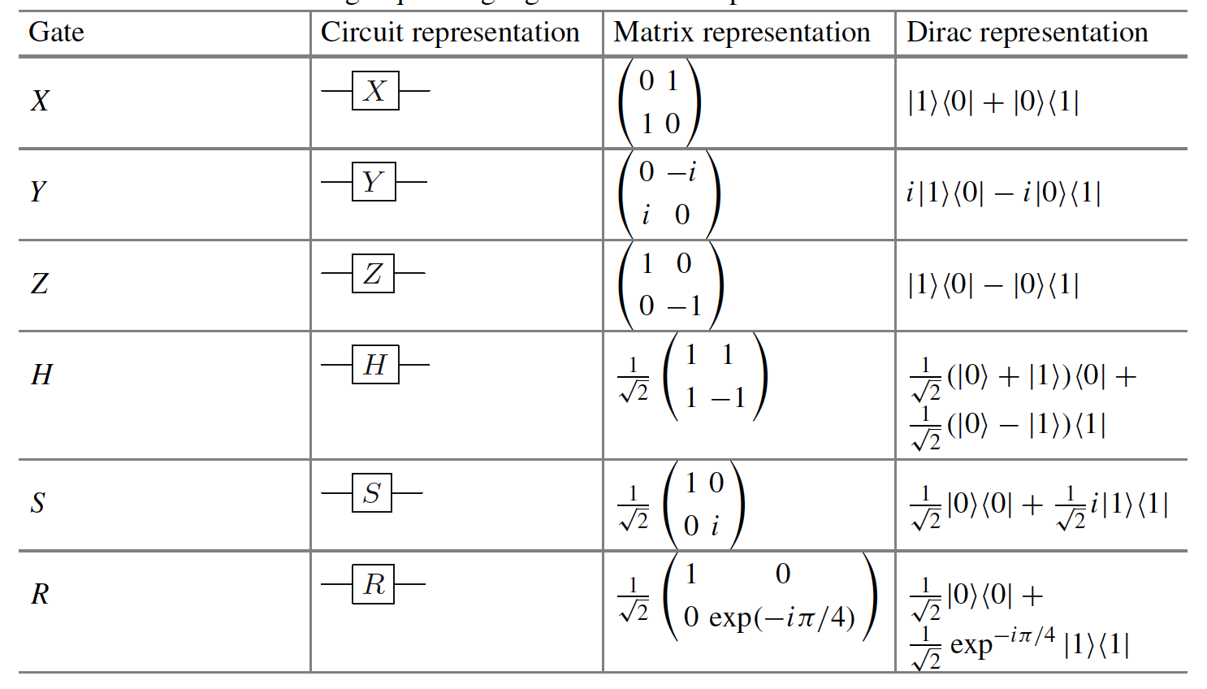


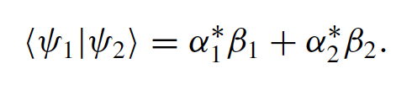
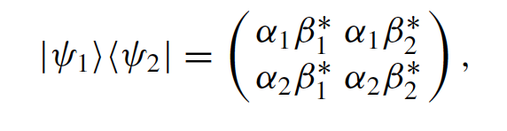
Quantum Gate Table

Slide 11

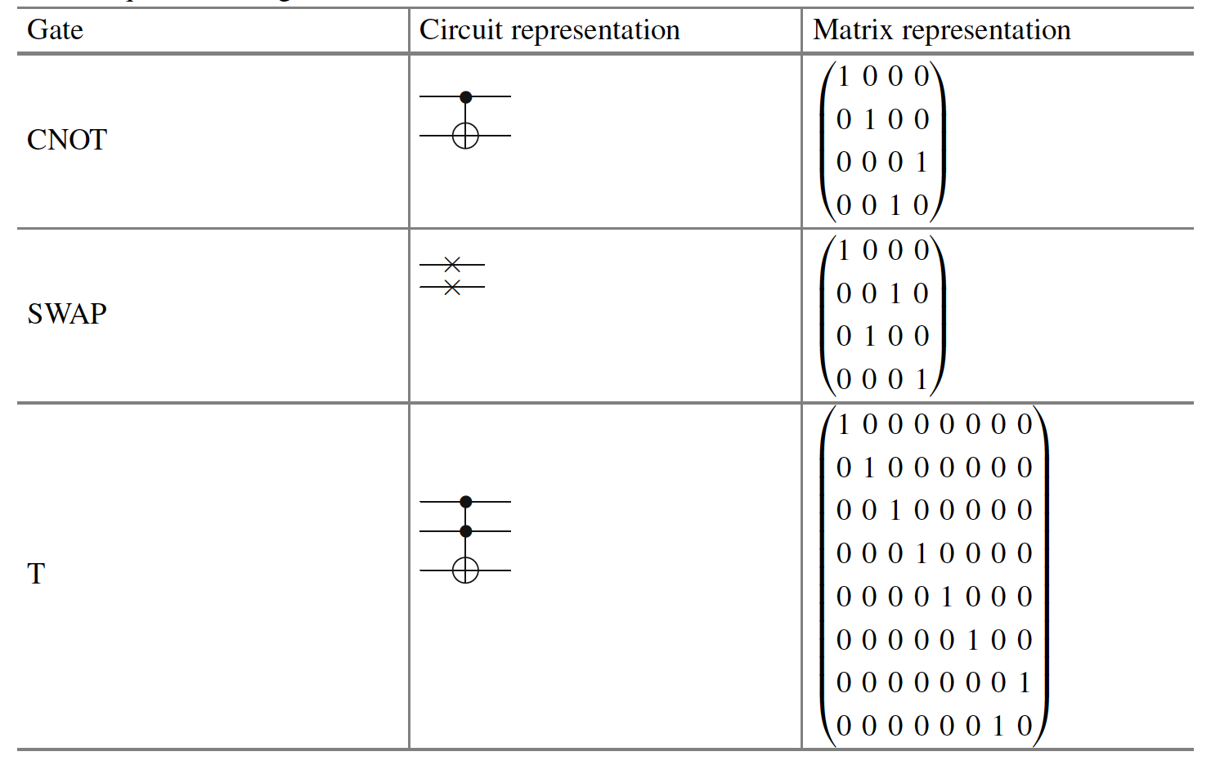
Other Useful Quantum Gates

Slide 12
Quantum Parallelism and Function Evaluation
Quantum parallelism is one of the most important and outstanding features of quantum computing. It allows quantum algorithms to evaluate multiple values at a time.

Slide 13

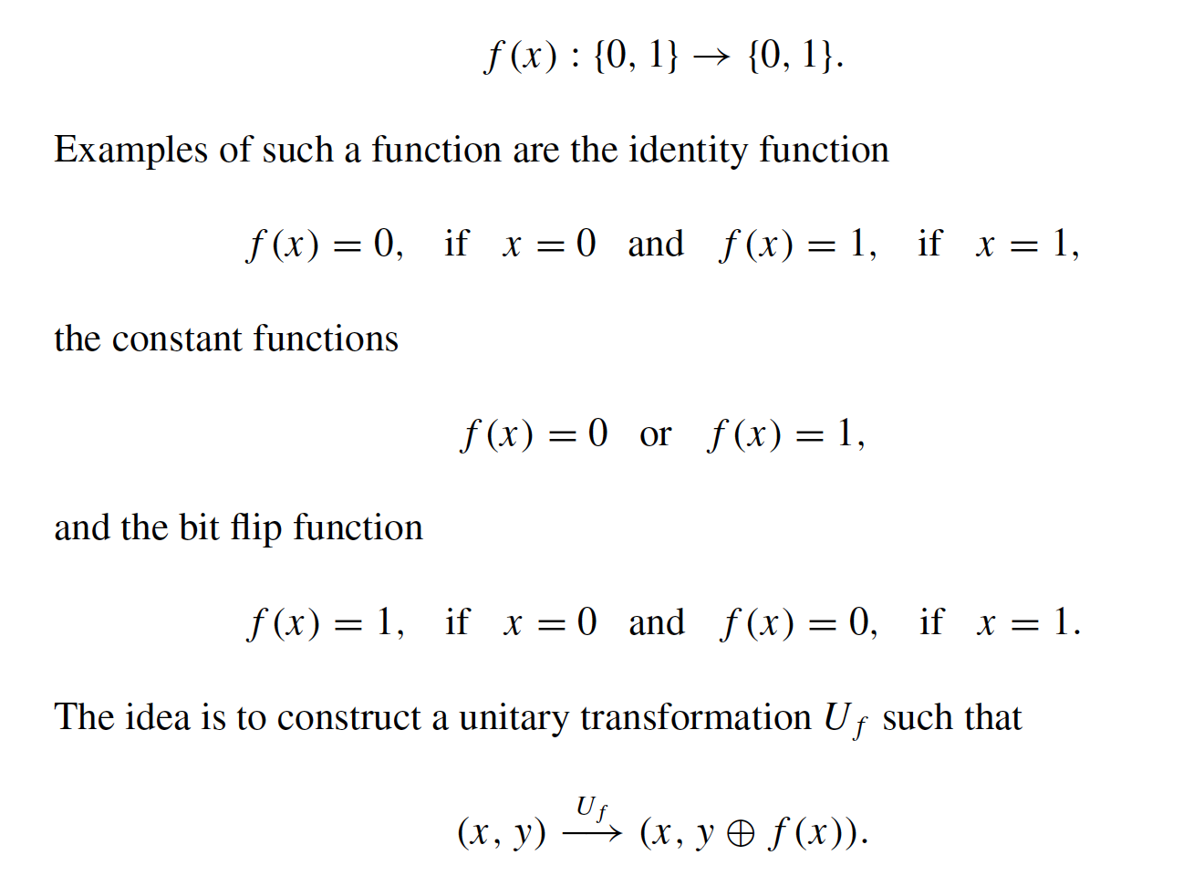

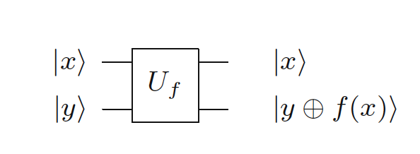
Example Function

Slide 14



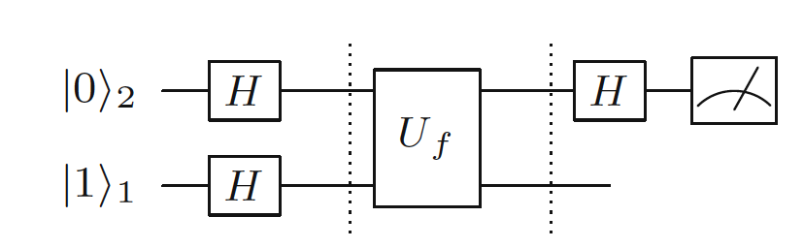
The Deutsch-Josza Algorithm
The Deutsch algorithm exploits the superposition to allow us to obtain information about a global property of a function f(x).
A function of a single bit (like in the example) can only be either constant or balanced. These properties are global and this algorithm will enable us to figure out if the function is either constant or balanced.
If the measurement of the input qubit is 0, then the function is balanced. If the measurement gives the state 1, then the function is balanced.

Slide 15

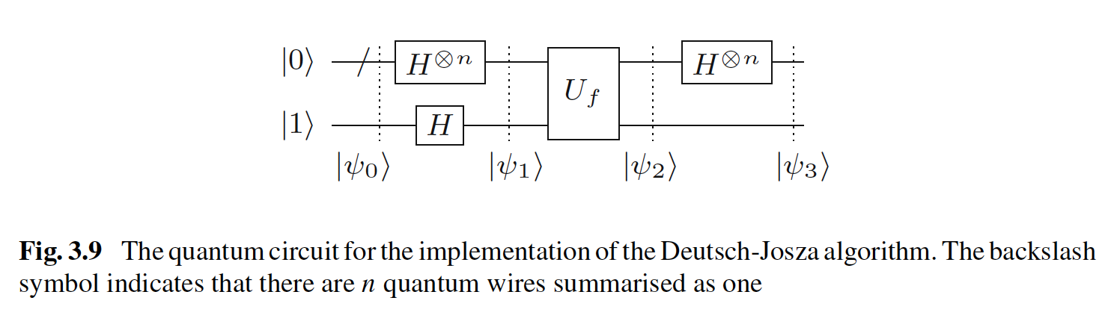
The Deutsch-Josza Algorithm
The algorithm can be generalized.

Slide 16
Quantum Annealing and Other Quantum Models
Quantum Annealing
One-Way (measurement based) Quantum Computing
Continuous-Variable Quantum Computing

Slide 17

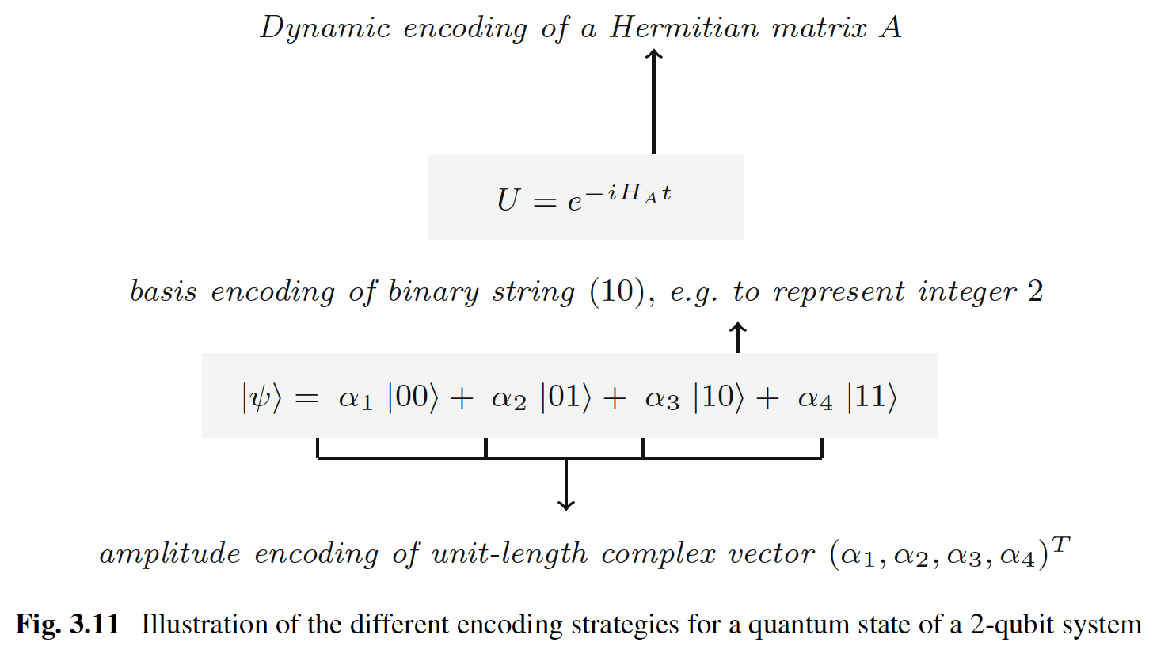
Information Encoding
Basis Encoding
Amplitude Encoding
Qsample Encoding
Dynamic Encoding

Slide 18

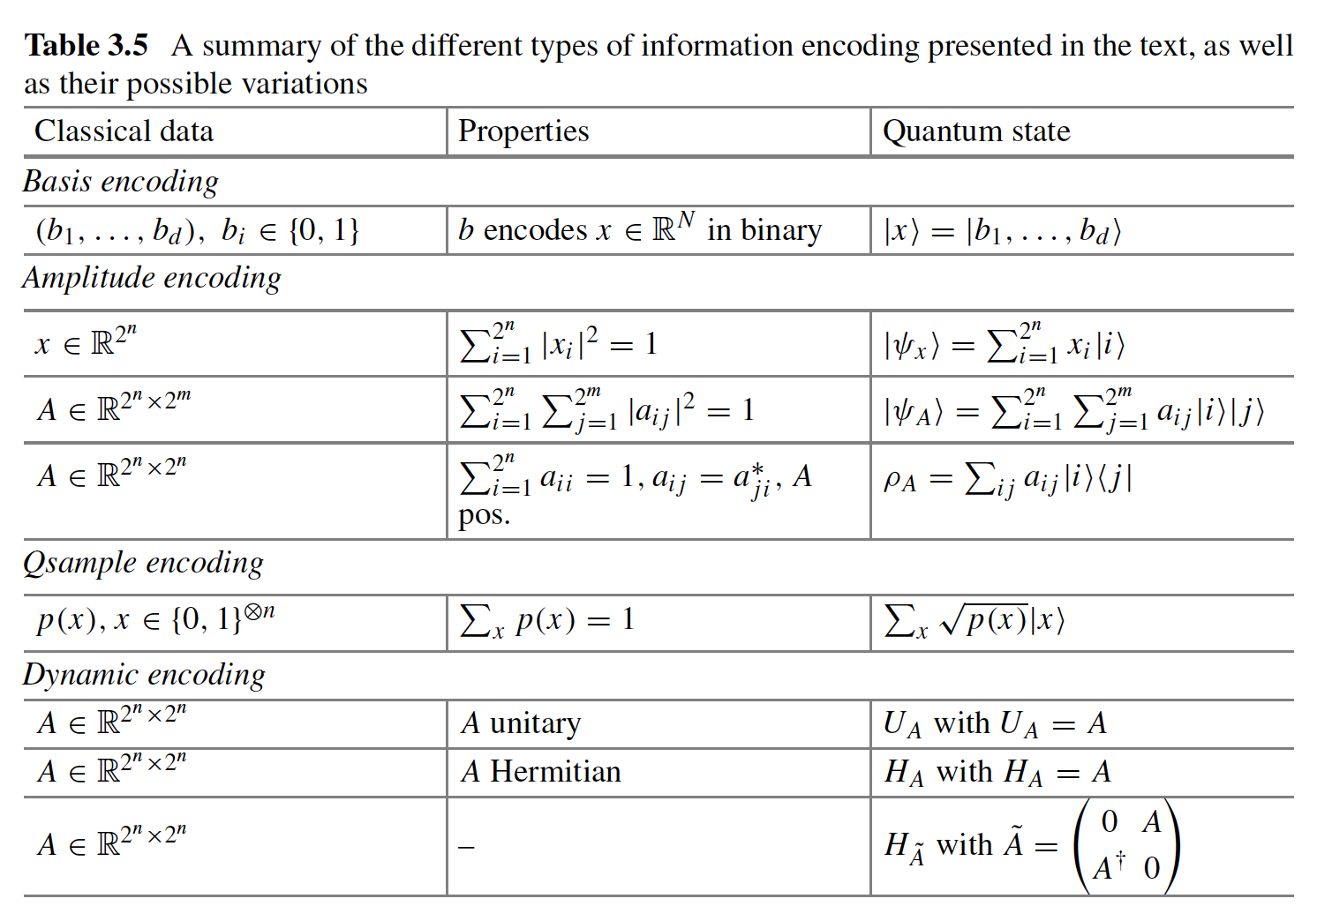
Information Encoding

Slide 19
Grover Search
Grover’s algorithm is a quantum routine that finds one or more entries in an unstructured database of N entries in basis encoding.

Slide 20
Grovers Search
This algorithm will search and mark the desired value, and amplify that values amplitude, such that a measurement will reveal the result of the computation.
Algorithm:
Mark desired state, using oracle and multiply amplitude by -1
Apply Hadamard transform on the index qubits
Apply a phase shift of -1 on ever computational basis state but the first one
Apply a Hadamard transform on the index qubits

Slide 21

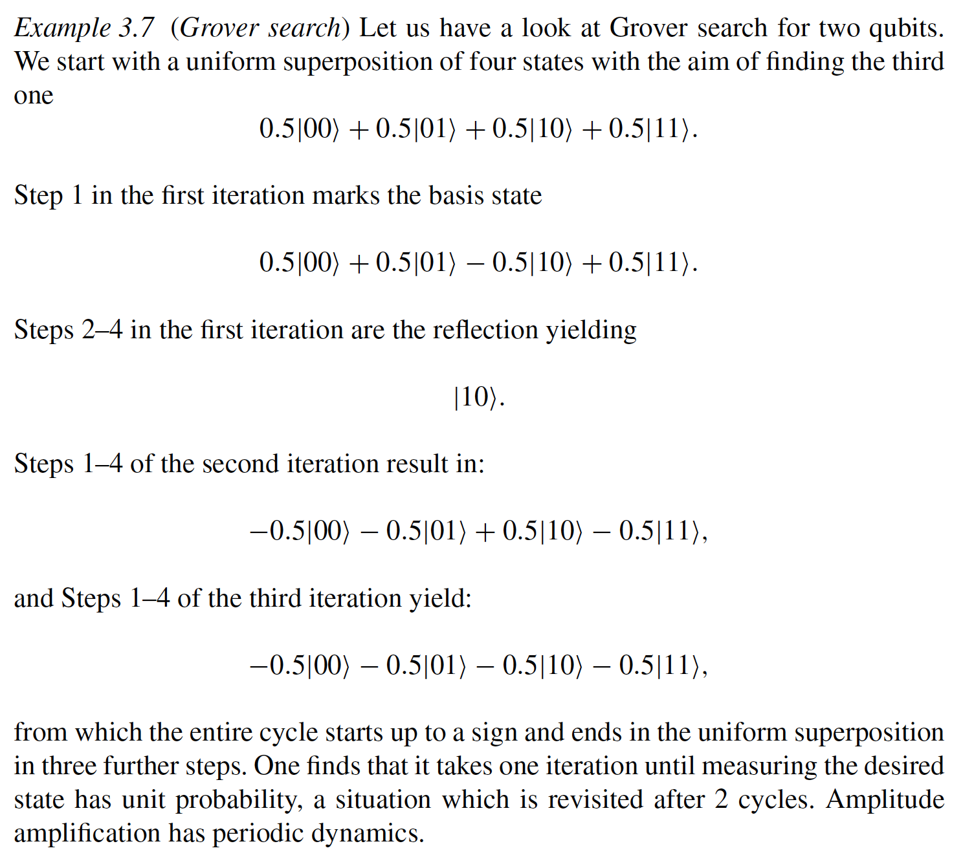
Grovers Search Example

